Slide 1
Cyberbully Lesson
By Scarlett Yuan

Slide 2
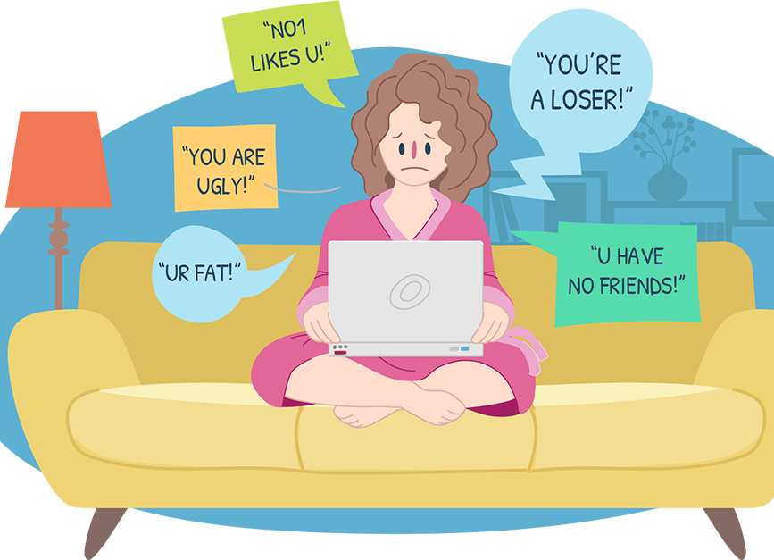
Define and determine the behaviors of a cyberbully
There are several ways that young people bully others online. By far, the most common behavior is verbal or emotional abuse, like name calling or sending offensive or threatening messages. Often, ones’ appearance, race, religion, ethnicity or sexual orientation is the basis for bullying.

Slide 3
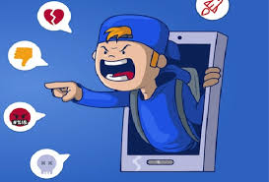
• Spreading rumours
• Sharing personal or embarrassing information about others, including photos or videos
• Imitating someone online (by gaining access to their accounts or creating fake accounts)
• Social exclusion where someone is intentionally left out of online social conversations or experiences (e.g. chat groups)
• Harassing players in an online game
• Posting offensive or inflammatory comments in online communities with the goal of instigating conflict (often referred to as ‘trolling’)

Slide 4
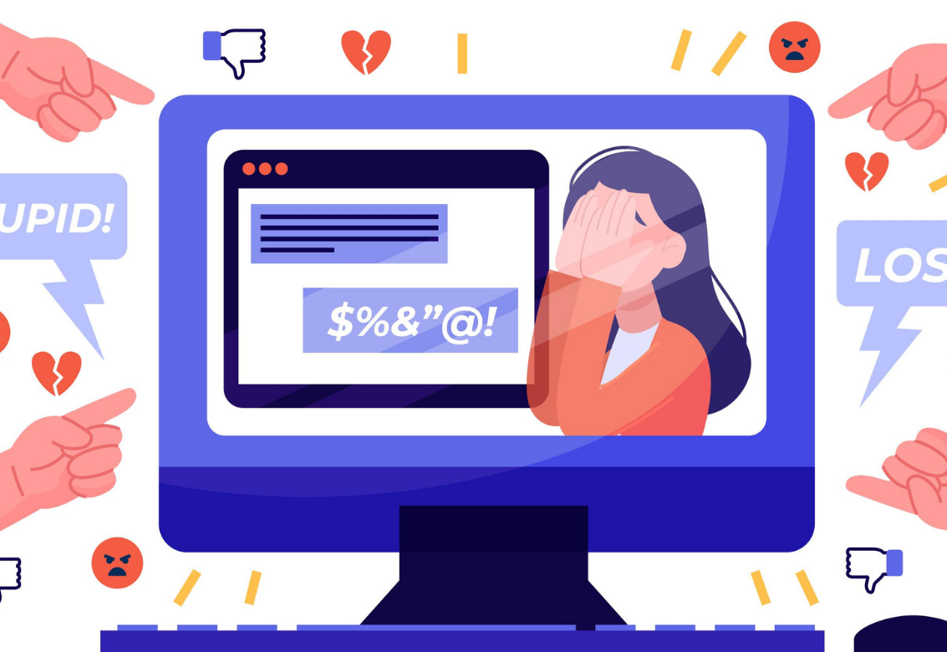
Assess if they or their friend are being a cyberbully

Slide 5

For girls: cyberbullying is often relational with girls most likely to be mean online to get back at someone who was mean to them or to a friend. We should encourage youth to talk things out with the person alone and offline (assuming they feel safe to do so), instead of calling on their friends for backup, which can lead to more drama that escalates into bullying.

Slide 6
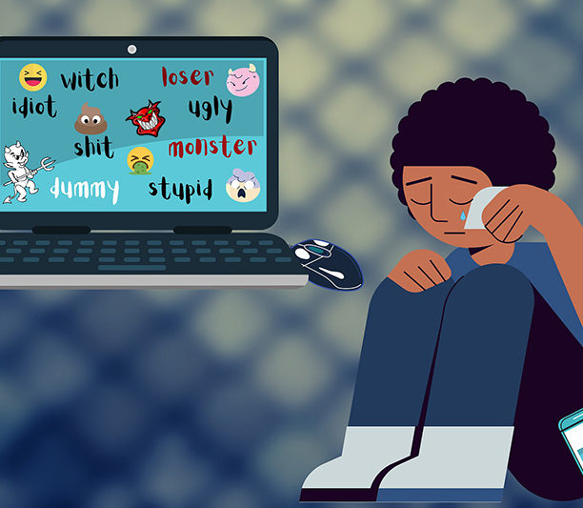
For boys: are significantly more likely than girls to harass others ‘just for fun’ by mocking their race, religion, ethnicity or sexual orientation, and/or sexually harassing others online. In-game harassment is particularly important for parents to be aware of, as this behaviour increases as boys get older. To counter this, we need to set clear guidelines with youth on our expectations around how they engage with others online and reinforce the need to be respectful in all online environments.

Slide 7

Kids and teens who may be marginalized for poverty, disability, being a member of a visible minority group, and/or identifying as LGBTQ+ are much more likely to be targets of cyberbullying.

Slide 8
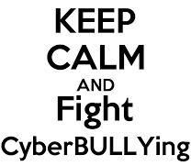

Stand up to cyberbullying

Slide 9

Comforting the person being targeted privately: One of the worst things about being bullied is feeling that nobody cares about what’s happening. Letting someone know you care can be a big help and won’t make things worse.
Helping the person being targeted report what’s happening or talk about it with their parents or friends. Kids say that helping them talk to parents or friends or report what’s happening is one of the best things witnesses can do.

Slide 10
Posting something nice about the person being targeted. If your kids want to do something public, they can let people know that they are supporting the person being targeted by posting something good about them.

Slide 11

Privately talking to the person doing the bullying. If your kids want to talk directly to the person doing the bullying, to avoid embarrassing them, they should send a private message or text.

Slide 12

If something is happening right now that they have to stop, they can try distracting the person who is doing the bullying or giving the person who is being targeted a chance to get out of the situation without being embarrassed (for instance, by changing the conversation, or sharing something unrelated, like a funny video).

Slide 13
4. Prevent and respond to the cyberbullying behavior
Engage in ongoing dialogue: Don’t wait for things to go wrong before engaging your child in a conversation about appropriate online behaviour; instead, have ongoing conversations about what your child does online starting at an early age. Your kids should be in the habit of talking to you about their everyday online lives, just like they tell you about their day at school. Remind your children to come to you right away if they feel uncomfortable or threatened online.

Slide 14
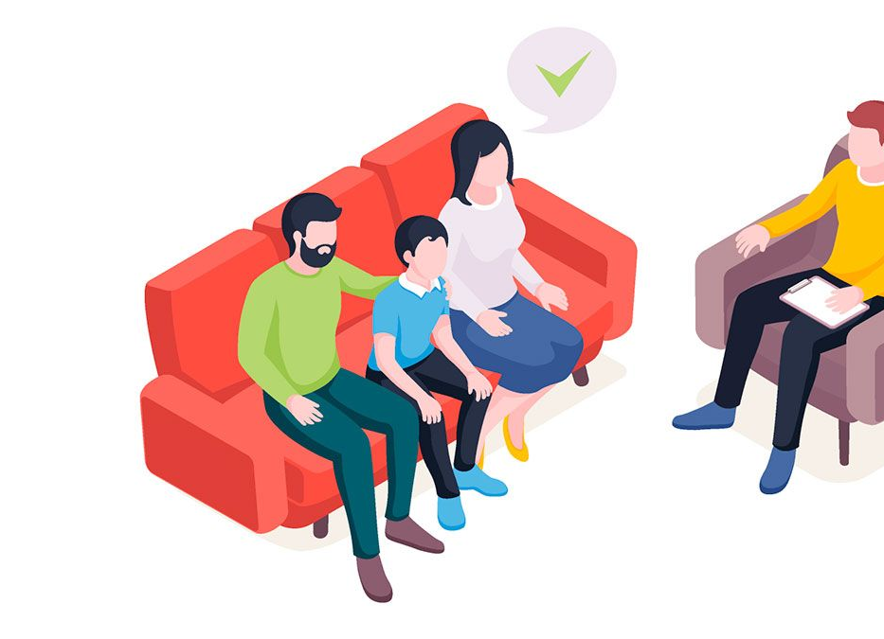
4. Prevent and respond to the cyberbullying behavior
Set rules, standards and boundaries: Establish clear rules about the values you expect your children to live by online, similar to the values you expect in their physical world. Technology can give people the sense of anonymity, sometimes making it easier for youth to cyberbully (intentionally or unintentionally) because they can’t see the hurt through the screen. It may seem hard to believe, but even teens are less likely to engage in cyberbullying if there is a household rule against it!1

Slide 15

4. Prevent and respond to the cyberbullying behavior
Educate and inform: To rise above cyberbullying we need to change the culture in which it happens. Youth need to understand that what may seem like “just a joke” can have a powerful and negative impact on someone else.

