Slide 1
The Endangered Animal
By Scarlett Yuan

Slide 2
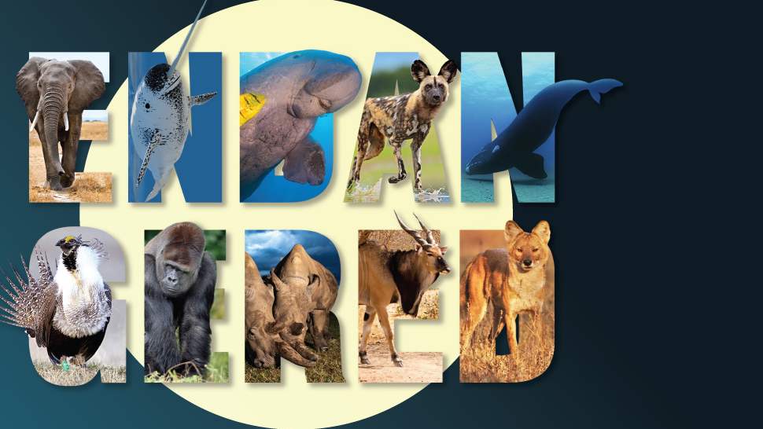
The Endangered Animal
Introducing the endangered species, and how they become a global concern.

Slide 3
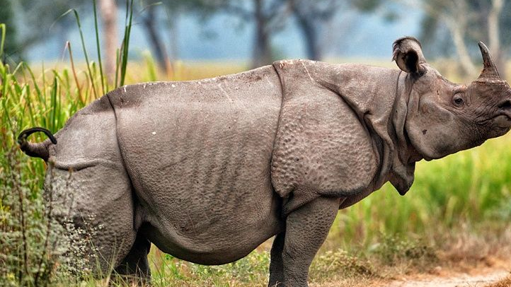
Javan rhinoceros
They’re heavy animals, weighing up to 2.3 tonnes.
They live for around 30-45 years in the wild.
They’re herbivorous, only eating plants.
They’re solitary animals, except for mating pairs and mothers with young.
They’re the second-largest animal in Indonesia after the Asian elephant.
Male Javan rhinos mark their territories with dung piles and by spraying urine.
Scrapes made by their feet in the ground and twisted saplings seem to be used for communication.
The cause of their population decline has mainly been caused by poaching due to excessive demand for rhino horns and medicine. Poaching ultimately wiped out the species in Vietnam.
Their food source in Ujung Kulon National Park is being taken over by out-of-control the invasive Arenga palm, but WWF-Australia is currently working to change that.

Slide 4
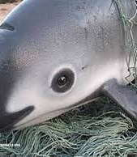
Vaquita
The vaquita is considered the rarest endangered marine mammal in the world. Sadly, the future looks bleak for this small porpoise, with just 10 left in the wild.
Found solely in the northern part of the Gulf of California, Mexico, they are fairly easy to spot due to the shallow water that they inhabit - lagoons generally no deeper than 30m. They'll quickly scarper if a boat sails by, though.
In the last few years, the population has dwindled at an alarming rate. Fishing nets, chlorinated pesticides, irrigation and inbreeding are just a few of the threats causing the species to teeter on the brink of extinction.

Slide 5
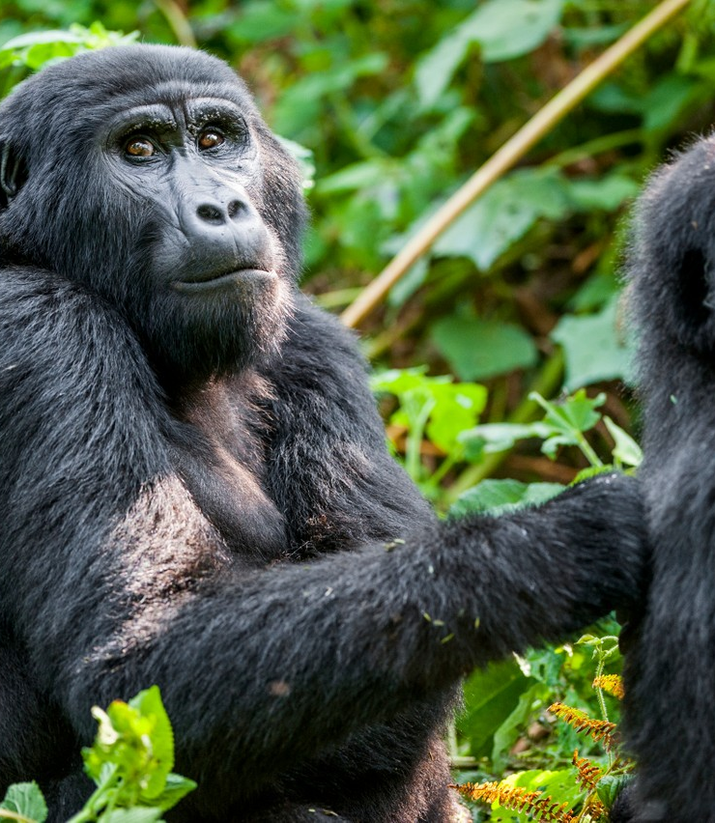
Mountain gorillas
Around 1,063 exist in the wild. ...
They live in two isolated groups. ...
We share around 98% of our DNA with gorillas. ...
They're one of the biggest, most powerful living primates. ...
They can eat all day long. ...
They cozy up at night. ...
They have 16 different types of call. ...
They live in family groups.

Slide 6
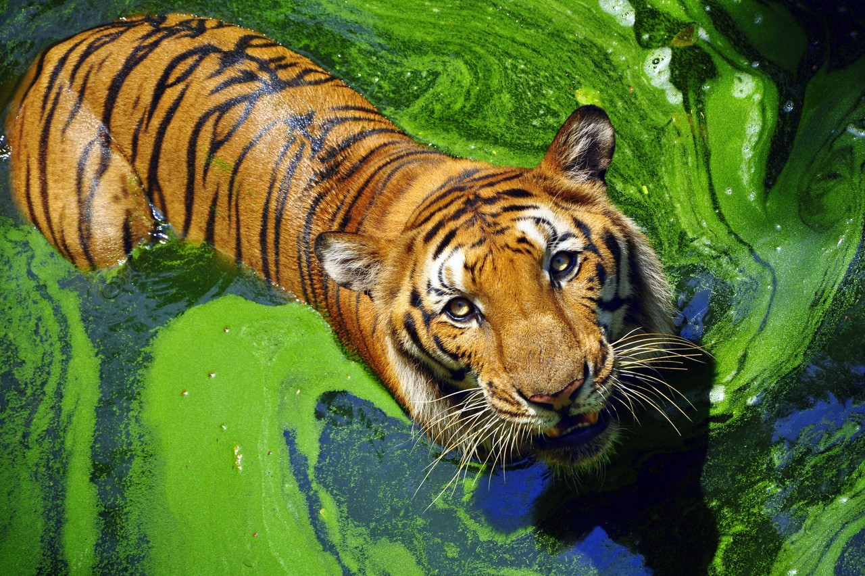
Tigers
What Makes Tigers Endangered? Several factors have negatively impacted these magnificent creatures. These include poaching, Illegal trade of tiger parts, loss of habitat, human conflict, and climate change. Perhaps the most significant factors are poaching and illegal trading of tiger parts.

Slide 7
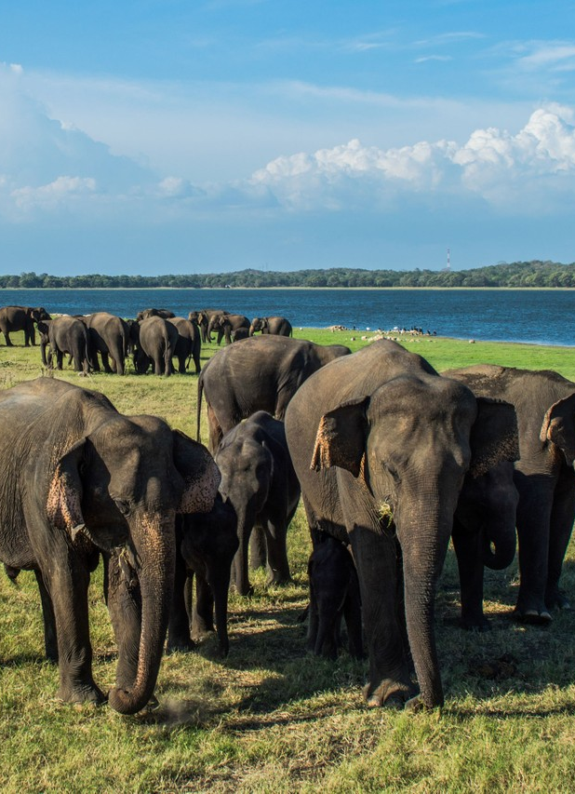
Asian elephants
Asian elephants are the continent's largest terrestrial mammals. They can reach 6.4m in length and 3m at the shoulder, and weigh as much as 5 tonnes. They are smaller than African elephants and have proportionally smaller ears, which they keep in constant motion in order to cool themselves.

Slide 8
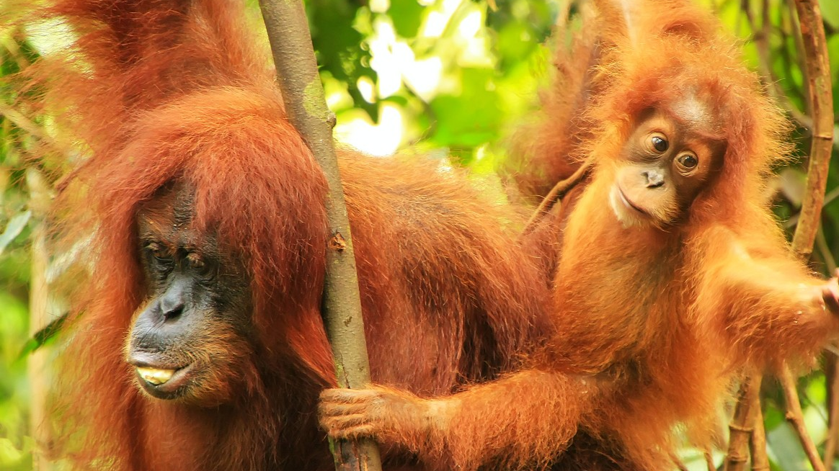
Orangutans
There are 3 species of orangutan. ...
Orangutans are the heaviest tree-dwelling animal. ...
They've got long arms. ...
They don't mind eating with their feet. ...
They learn everything they need to know from mum. ...
Males are majestic. ...
They build nests to sleep in. ...
Some orangutans use tools.

Slide 9
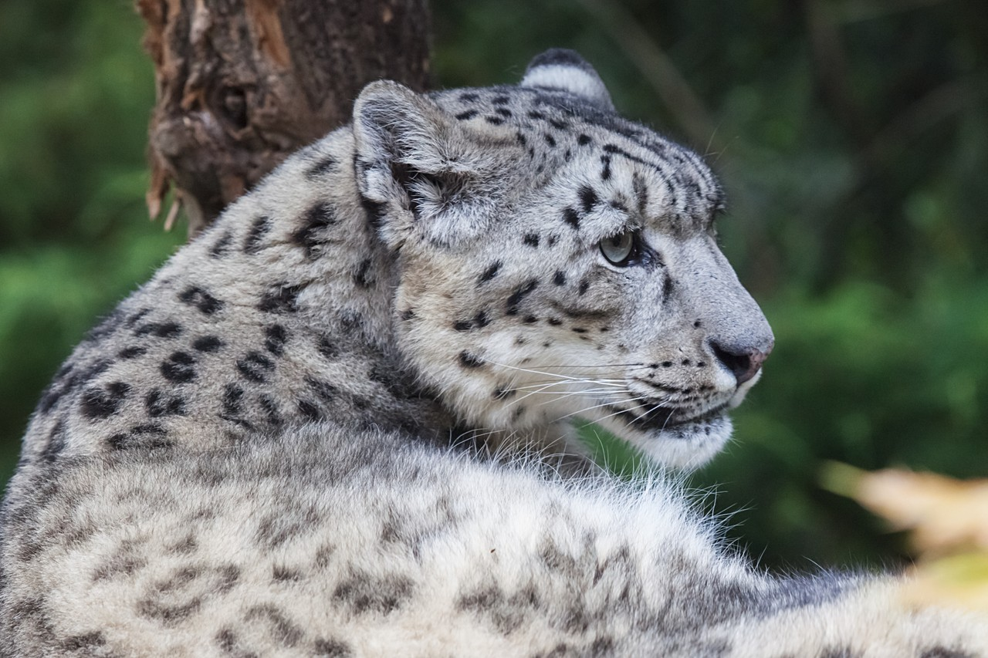
Snow leopards
They're well adapted to their cold environment. ...
In Nepal, their main prey are blue sheep…which aren't actually blue. ...
High altitude acrobats. ...
They can't roar. ...
They're more closely related to tigers than they are leopards. ...
They have natural snowshoes.

Slide 10
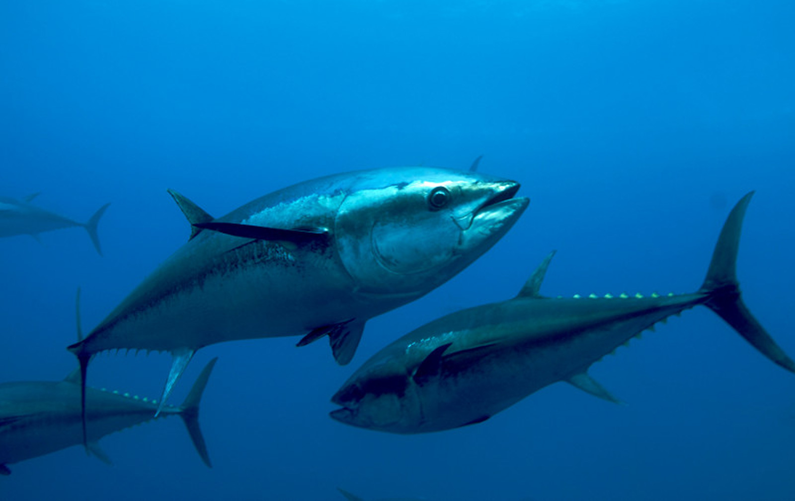
Atlantic bluefin tuna
Atlantic bluefin tuna are the largest tuna species. ...
Atlantic bluefin tuna can live for 35 years, possibly longer. ...
Female Atlantic bluefin tuna produce up to 10 million eggs a year. ...
Atlantic bluefin tuna are top predators, feeding on fish such as herring and mackerel as adults.

Slide 11
Why are animals going extinct from climate change?
Climate change leads to a loss of species
Our planet is warming faster than at any time in the past 10,000 years. With these changes, species have to adapt to new climate patterns (variations in rainfall; longer, warmer summers etc).
Global warming resulting from human emissions of greenhouse gases. The consequences include habitat loss; shifts in climatic conditions and in habitats that surpass migrational capabilities; altered competitive relationships.
Changes already underway
Evidence suggests that the warming of the past century already has resulted in marked ecological changes, including changes in growing seasons, species ranges, and patterns of seasonal breeding.
Growing need for adaptations
The fate of many species in a rapidly warming world will likely depend on their ability to migrate away from increasingly less favorable climatic conditions to new areas that meet their physical, biological, and climatic needs.

Slide 12
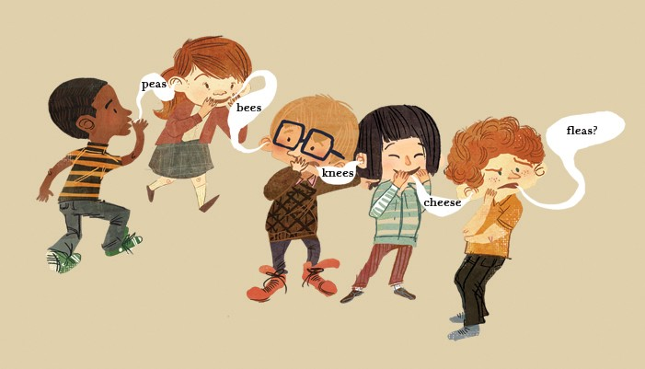
Telephone Games
Students have to pass the secret message down the line from student-to-student. The person at the end say out loud the name of the endangered animals

Slide 13
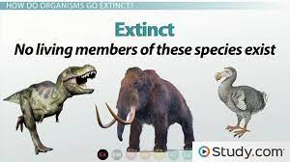
difference between the terms threatened, endangered, and extinct.
https://study.com/academy/lesson/differences-between-endangered-species-and-threatened-species.html

Slide 14
Quick Quiz Reflection

Slide 15
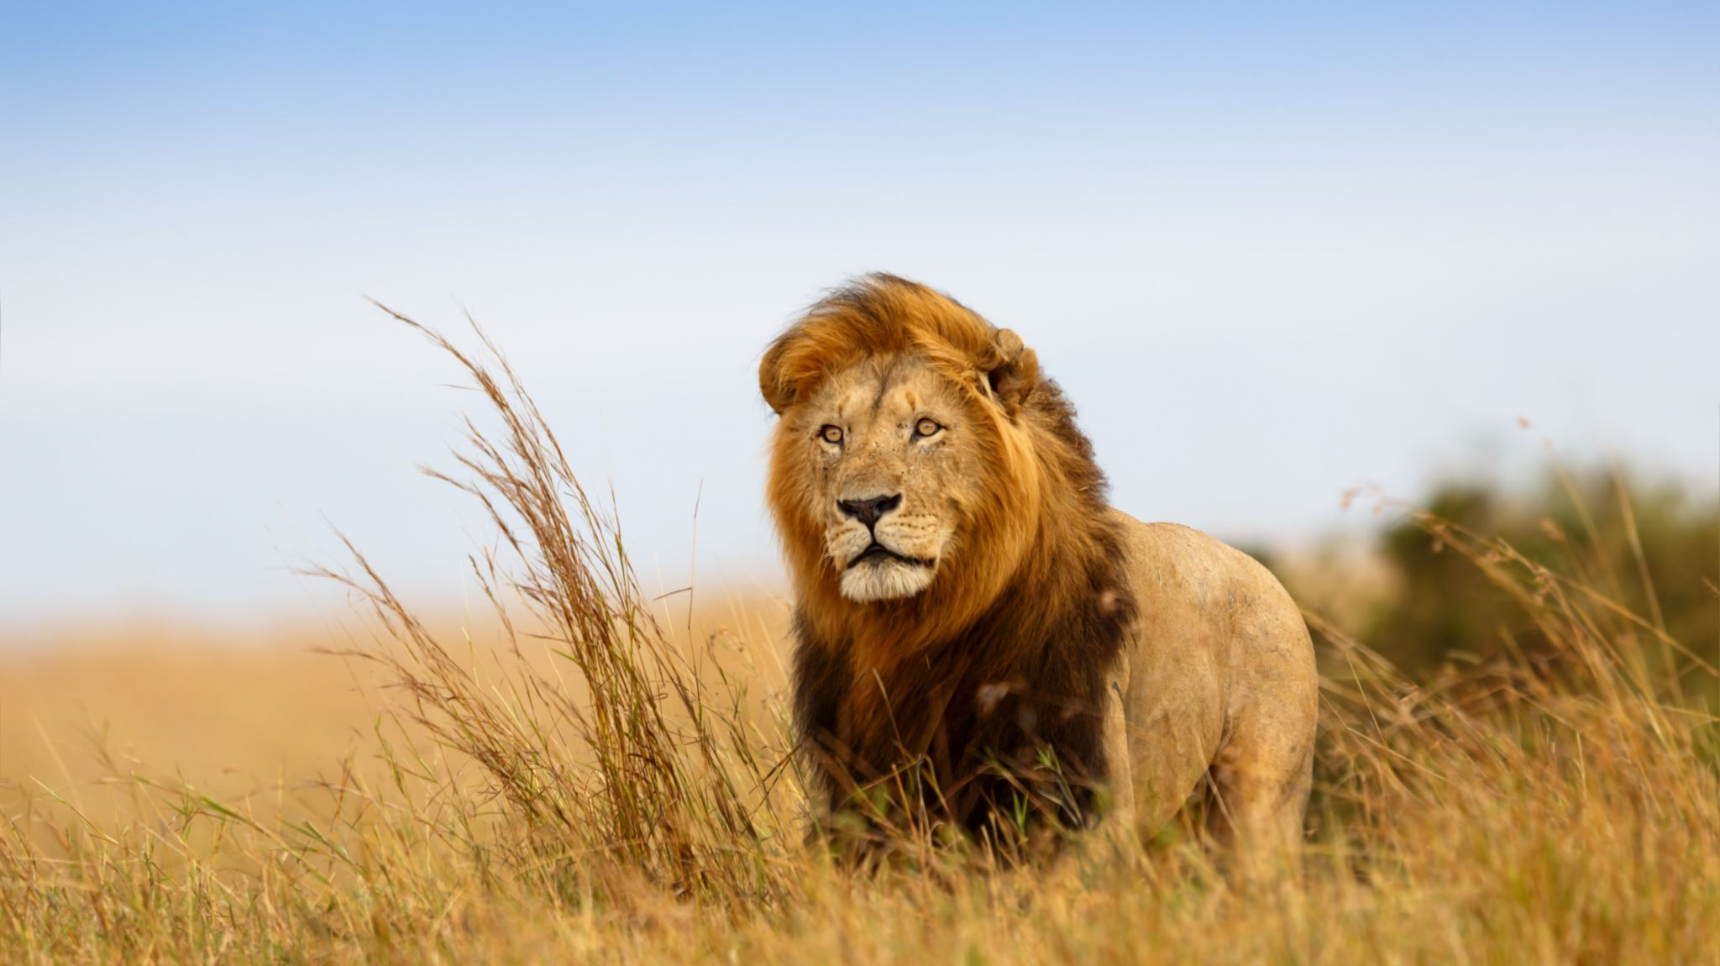
What is one major reason that we study endangered species?

Slide 16
Plants and animals maintain the health of an ecosystem.
When species become endangered, it's a sign that an ecosystem is out of balance. But the balance within an ecosystem isn't always easy to maintain: the loss of one species often triggers the loss of others.

Slide 17
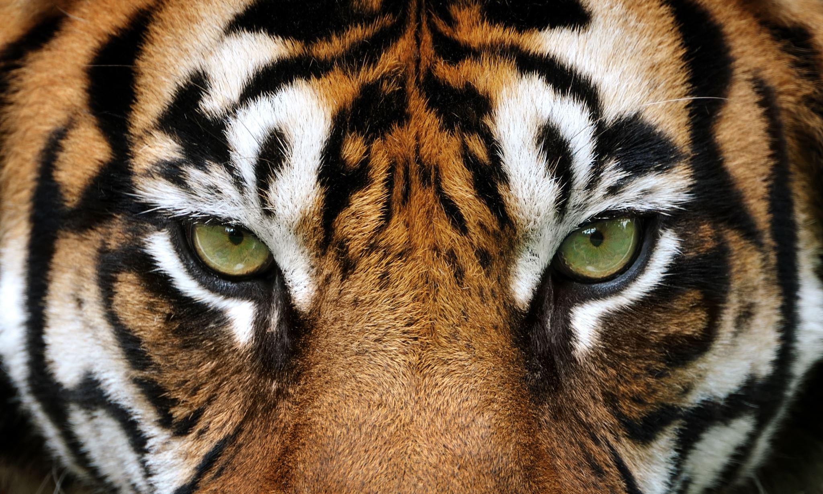
How are endangered/threatened species determined?

Slide 18
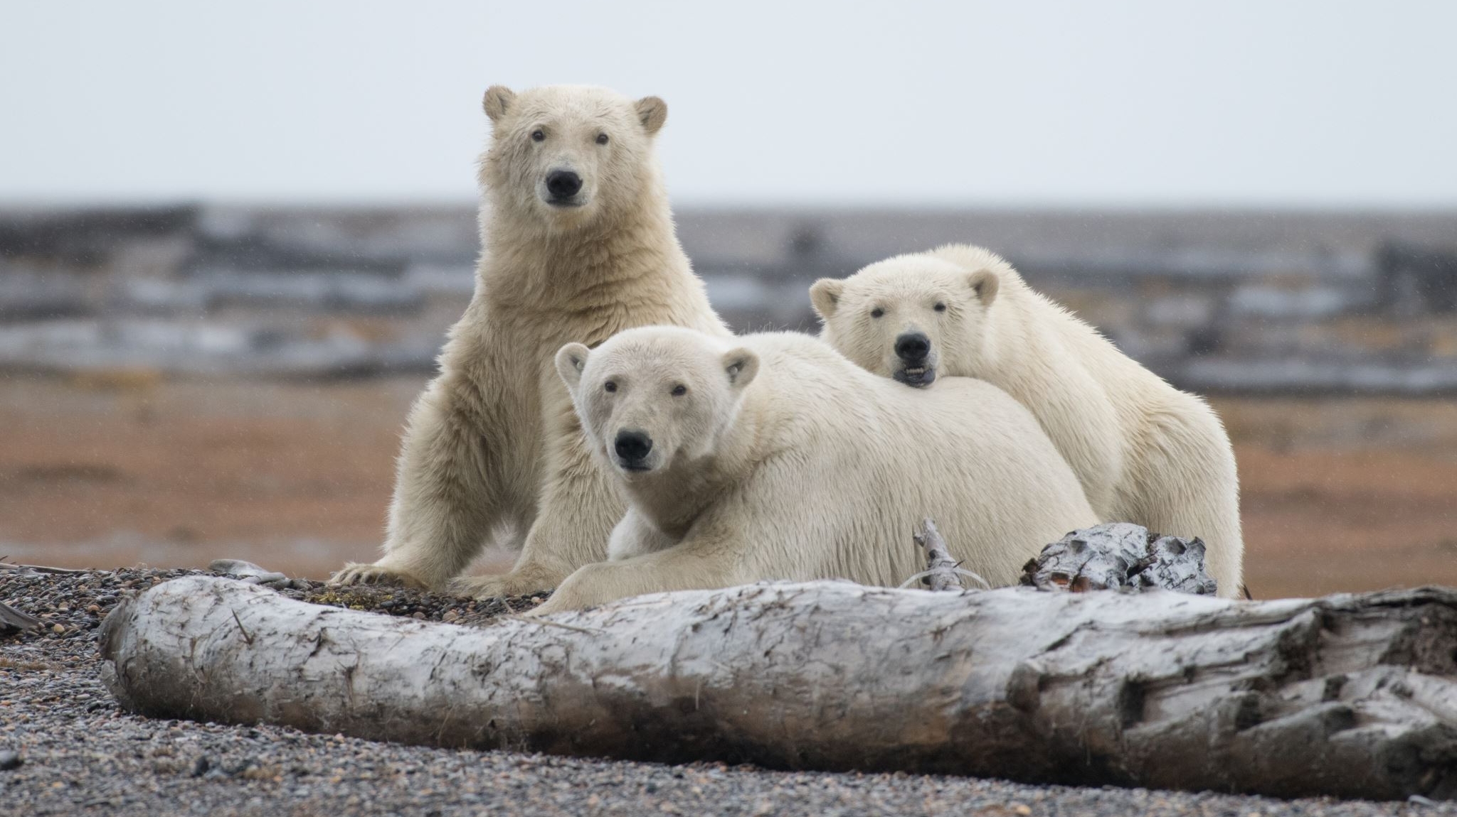
What is the difference in the terminology of threatened, endangered, and extinct? Give examples of species from each category.

Slide 19
facts about select endangered species around the world
Endangered species are those species that are at a risk of becoming extinct due to man’s intervention for their fur, habitat loss, climate change, disease, hunting. Endangered species have a small or declining population, meaning that there are so few left and could extinct anytime in near future. The current rate of extinction is far more than the expected natural rate and should be a cause of concern for all of us. These species help us to main ecosystems by providing clean air, water, medicines, food, building and clothing material.

Slide 20
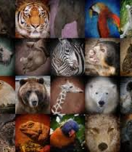
“An endangered species is a species which has been categorized as likely to become extinct. Endangered (EN), as categorized by the International Union for Conservation of Nature (IUCN) Red List, is the second most severe conservation status for wild populations in the IUCN’s schema after Critically Endangered (CR).”

Slide 21
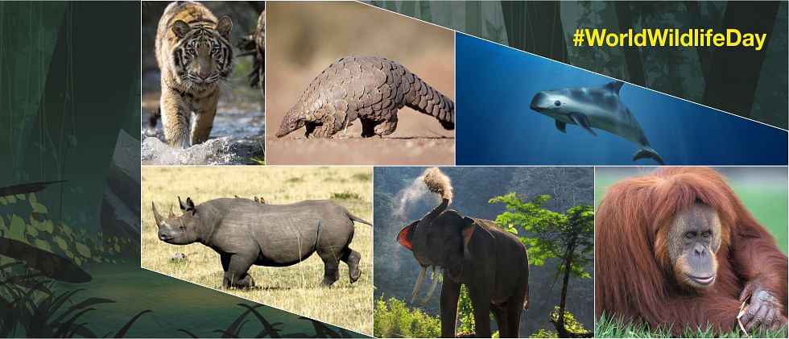
Discuss endangered species around the world & figure a way to protect animals

Slide 22
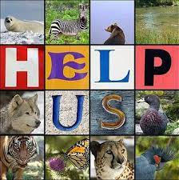
Help to save the endangered species.
Learn about endangered species in your area.
Create a backyard wildlife habitat. Put bird feeders and other wildlife attractants, such as bird houses and baths.
Establish a pollinator garden with native vegetation in your yard. Native plants provide food and shelter for native wildlife. Attracting native insects like bees and butterflies can help pollinate your plants. Avoid planting invasive species. Non-native plants can overtake and destroy native species on which animals depend.

Slide 23
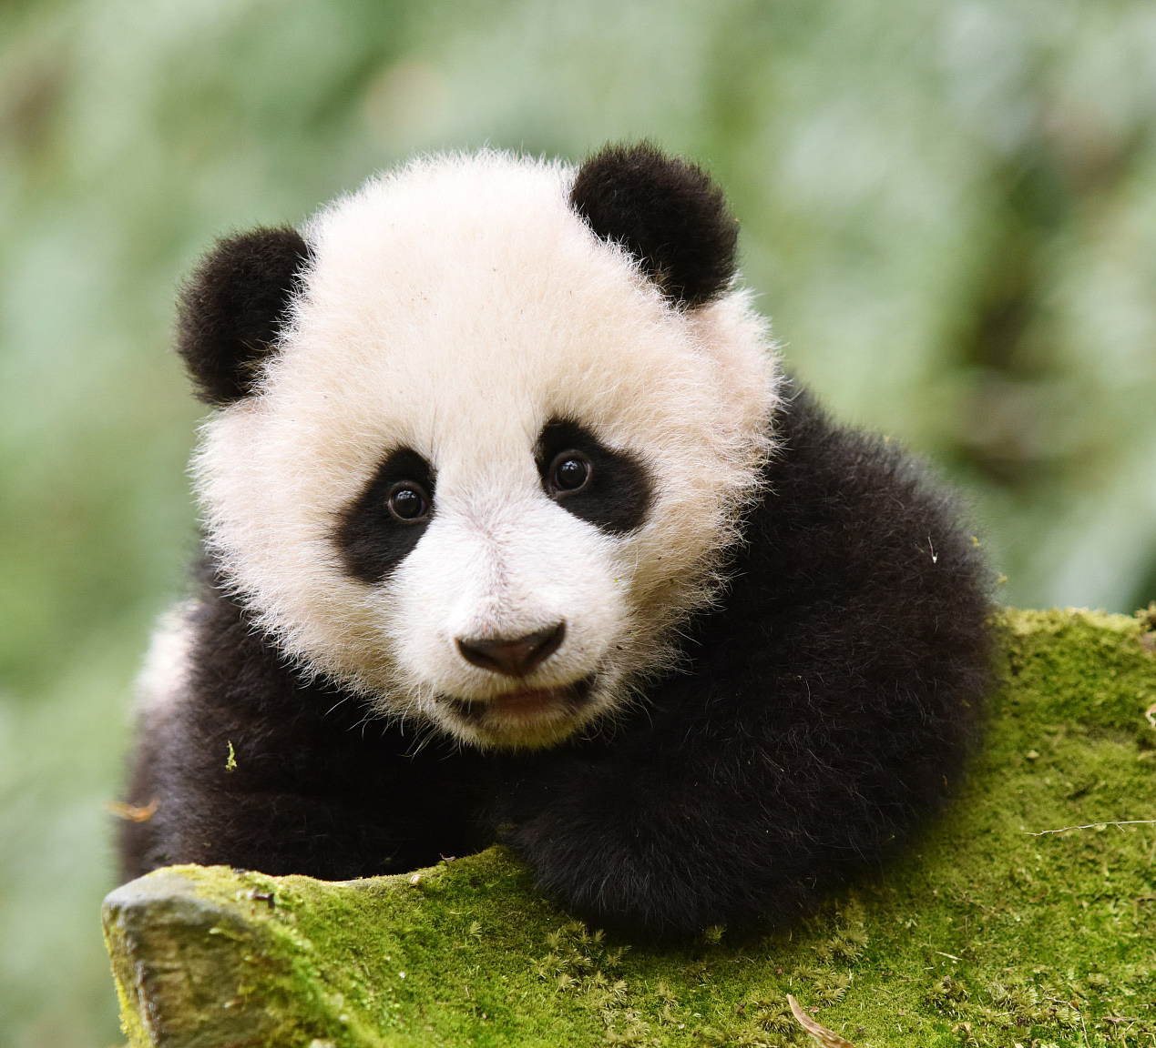
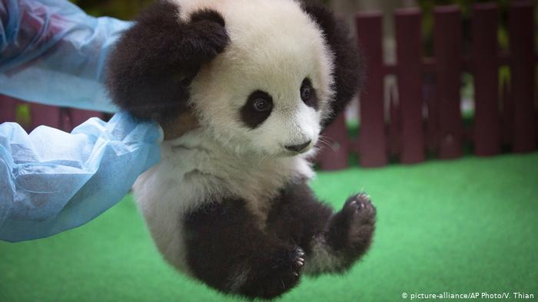
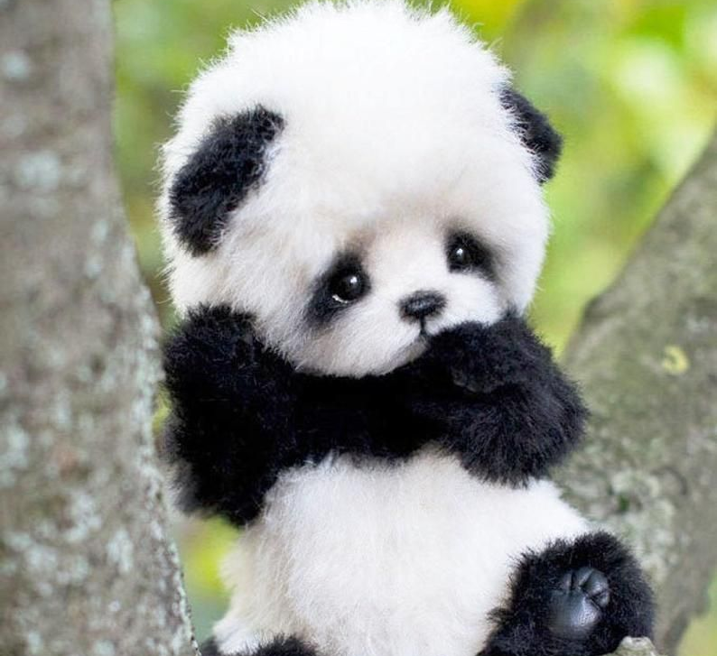
Help to save the endangered species.
6) Place decals on windows to deter bird collisions. Millions of birds die every year because of collisions with windows. You can help reduce the number of collisions simply by placing decals on the windows in your home and office.
7) Slow down when driving. Many animals live in developed areas and this means they must navigate a landscape full of human hazards. So when you’re out and about, slow down and keep an eye out for animals. Don’t litter because trash can attract wildlife to the roadside.
8) Recycle and buy sustainable products. Buy recycled paper and sustainable products like Forest Stewardship Council wood products and shade-grown coffee to save rainforests.

Slide 24








Saving Endangered Species

Slide 25

Wild ARC’s
The mission of the BC SPCA Wild Animal Rehabilitation Centre (Wild ARC) is to provide care to injured, sick, orphaned and distressed wildlife based on rehabilitation standards and the animal’s natural history. We treat each animal in our care as an individual case. The goal of rehabilitation is to release recovered animals back into the wild. Human activity affects over 80 percent of the animals treated at Wild ARC. We aim to reduce this impact, and educate the public about wildlife, animal welfare and co-existing with nature. Check out our critter cam to view some of our current patients or subscribe to WildSense to receive our newsletter focusing on wildlife stories and issues in B.C.

Slide 26
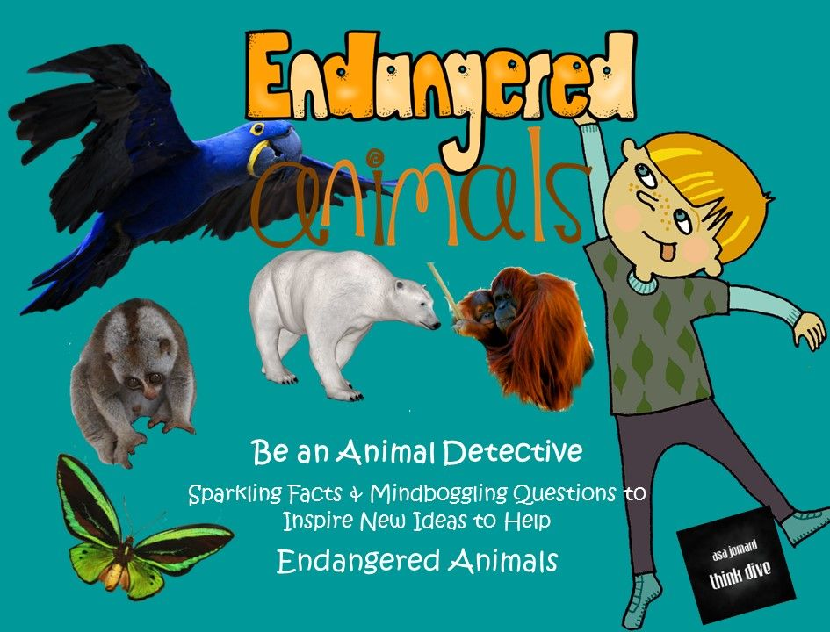
The endangered species detective
Each group will pick an endangered animal they would like to learn about, detected it and introduce to the class why the species is endangered, and how we can help.
Vote for your favourite group, winner get a point.

Slide 27

Questions?

Slide 28
Assignment
Take Homehttps://scratch.mit.edu/projects/556072616
Group Poster

Slide 29



Field Trip Discussion

Slide 30

Enjoy your artwork time

Slide 31

Thank you for watching

Slide 32
Reference
Wanderlust. 10 of the world's most endangered animals. (2020). Retrieved from https://www.wanderlust.co.uk/content/10-of-the-worlds-most-endangered-animals/
A growing need for species to adapt to a changing world. Retrieved from https://wwf.panda.org
Wild ARC. Retrieved ftom https://spca.bc.ca/programs-services/wildlife-rehabilitation/about-wild-arc/

